Slide 1
HOW DOES ANTIMICROBIAL RESISTANCE OCCUR?
There is usually a small number of bacteria that mutate and
become resistant to antibiotics
When we take antibiotics, they kill all susceptible bacteria, including the “good” bacteria that protect the body
from infection
The drug-resistant bacteria survive and multiply. Eventually, the drug-resistant bacteria become dominant and
antibiotics stop working

Slide 2
INAPPROPRIATE USE OF ANTIBIOTICS LEADS TO ANTIMICROBIAL RESISTANCE
This is a serious global challenge.
That means that the antibiotics
we have today will be less efective in the future in treating
life-threatening infections
EFFECTIVENESS
PRESENT FUTURE
Currently AMR is afecting millions of people worldwide and kills more than 1 million people per year

Slide 3
EVERYONE IS RESPONSIBLE FOR CONTRIBUTING TO THE PROBLEM OF ANTIMICROBIAL RESISTANCE
Scan the QR code to calculate your own antibiotic footprint and learn more about antimicrobial resistance
SCAN ME

Slide 4
MORE RESEARCH IS NEEDED TO DEVELOP NEW ANTIBIOTICS
That is why we need to protect and preserve our current antibiotics for as long as possible

Slide 5
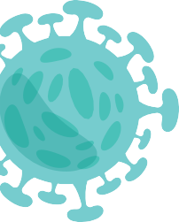
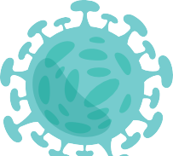
ANTIBIOTICS WON’T TREAT YOUR COLD OR THE FLU
Antibiotics are only efective against infections caused
by bacteria, and only your doctor can decide whether you should take them or not

Slide 6
YOU SHOULD NEVER TAKE LEFTOVER ANTIBIOTICS WITHOUT CONSULTING YOUR DOCTOR FIRST
YEAST INFECTION
DIZZINESS NAUSEA
RASH DIARRHEA
Antibiotics cause side efects and when used inappropriately they can become less efective
in the future

Slide 7
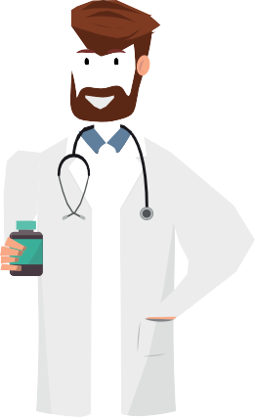
NEVER SHARE ANTIBIOTICS WITH YOUR FRIENDS & FAMILY
The pharmacists can recommend some over-the-counter medication to alleviate symptoms, until consulting a doctor
PHARMACY

Slide 8
MORE INFORMATION ABOUT HAPPY PATIENT
HAPPY
PATIENT
TRAINING HEALTHCARE PROFESSIONALS AND EMPOWERING THE PATIENT
SCAN ME
and acces to our website and material

